Slide 1
Chapter 2
Peer-to-peer (P2P) applications

Slide 2
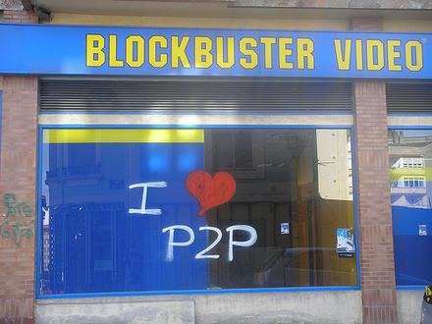
P2P Systems
Characteristics
No always-on server
Arbitrary end systems directly communicate
Peers are intermittently connected and change IP addresses
Unstructured P2P systems
Bit-Torrent, TOR, Blockchains
Structured P2P systems
Distributed Hash Tables (DHTs)
What are some examples of P2P systems in use today?
Notes:
P2P systems: Torrent, Skype, ToR, Coral CDN, Spotify, BitCoin

Slide 3
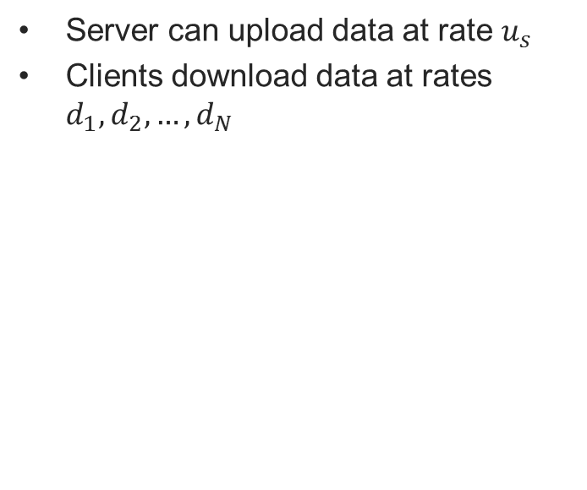
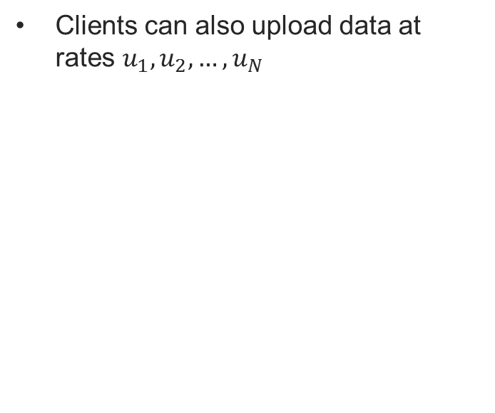

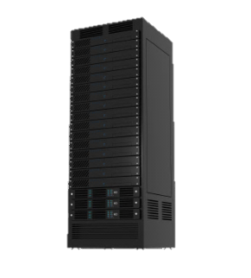
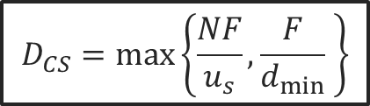
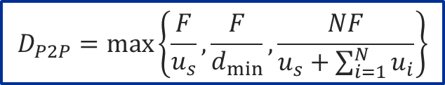
Scalability of P2P Architectures
Client-Server architecture
P2P Architecture
Client
Client
Client
Client
Internet
Server
Server
Client
Client
Client
Client

Slide 4
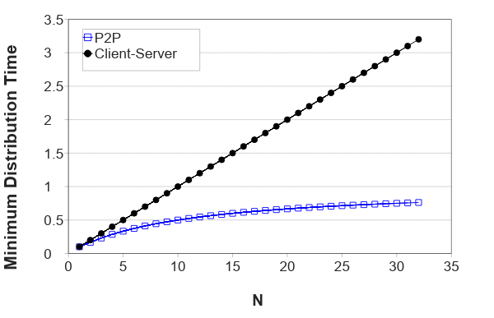
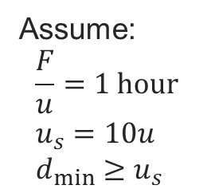
Distribution time
Client server distribution time grows with the number of clients
P2P distribution time approaches 1 hour as number of clients grows
P2P architectures are self-scaling

Slide 5

Torrent swarm
Key Motivation:
File popularity exhibits temporal locality
Flash crowds, Slashdot effect, etc.
Functionality
File chunks distributed to peers
Collaborative download
Has some “real” publishers
Mechanism - Swarming
Publish: Run a tracker server
Search: Out-of-band
Join: get list of peers from tracker
Fetch: Direct shard exchange with peers

Slide 6
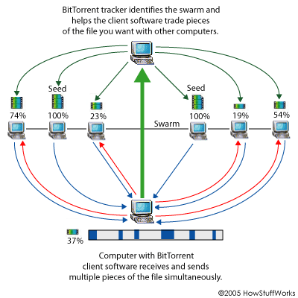
BitTorrent continued
Torrent swarm
Which chunks to download?
Rarest first mechanism
Equalizes the number of copies of each chunk in the system
From which peers to download?
“Tit-for-tat” sharing strategy
Allow download to N peers with highest upload rates
Allows peers with similar upload rates to find each other
How to bootstrap peers?
Opportunistic unchocking mechanism
Allows download from random peer
Allows new peers to start
Allows shift to download from faster peers
What are some limitations to BitTorrent scalability?
Notes:
What are some limitations to BitTorrent scalability?
Leechers!
Single tracker

Slide 7
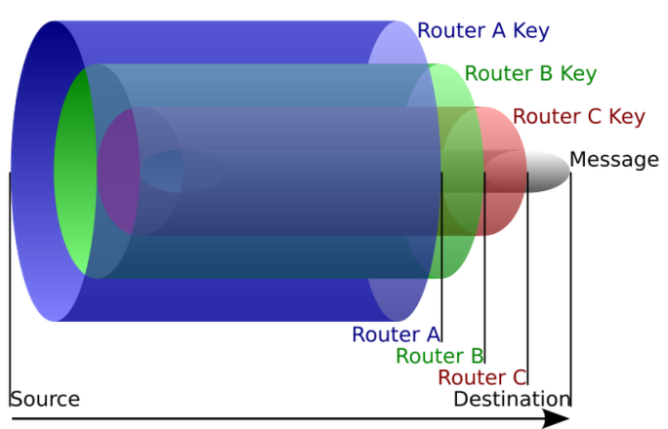
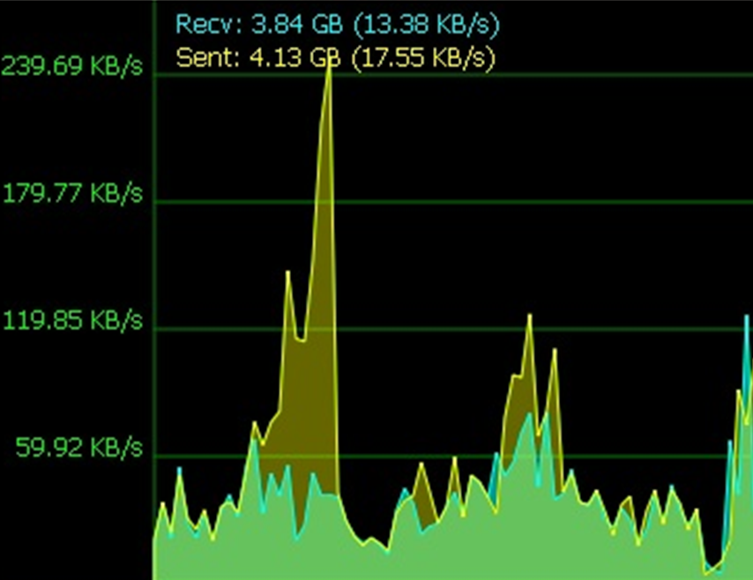
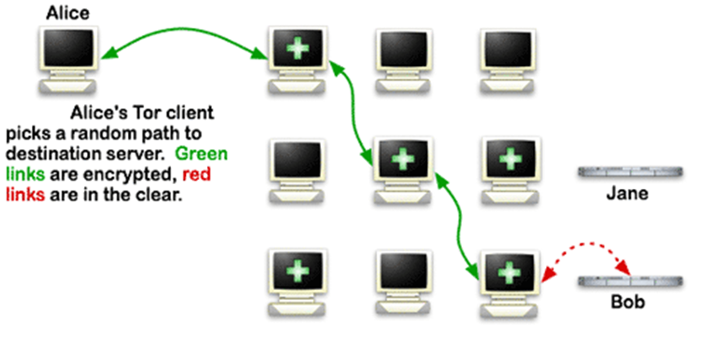
Unstructured P2P Middleware
The onion router (TOR)
History
Deployed in 2002
Conceal user’s identity and network activity
Functionality
Sender obtains a set of router keys
Each router only knows next hop
Intermediate routers cannot read message
Vuze includes built-in Tor support
Can be used to access the darknet
Invisible Internet Project (I2P)
Support pseudoanonymous services
Fully distributed node database

Slide 8
Blockchains
block_no: 0
data [...]
prev_block_hash: 0
nonce: 1467
block_hash: 004A56
block_no: 1
data [...]
prev_block_hash: 004A56
nonce: 4378
block_hash: 00B49C
block_no: 2
data [...]
prev_block_hash: 00B49C
nonce: 2839
block_hash: 00EEA5
A miner sends a new block to other miners, who verify it and start working on the following block
A series of cryptographically linked blocks
Cannot modify older blocks without modifying newer ones
Consensus over data, and so over a series of distributed system actions
Monetary transfers
Smart contract executions

Slide 9
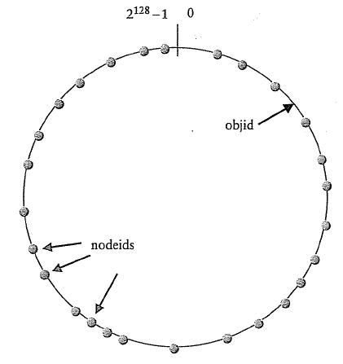
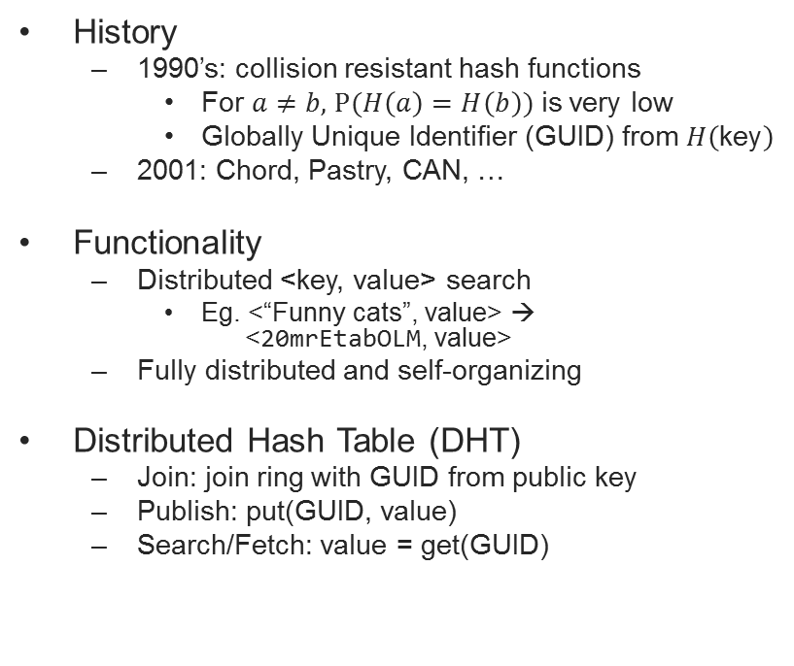

Structured P2P
“Funny cats” → 20mrEtabOLM
Notes:
Example of lookup
Example of join

Slide 10
Search in a structured P2P
0
FFFFF....F (2¹²⁸-1)
Each node maintains links to 4 closest nodeids in each direction
Queries for objid forwarded to closest nodeid in the routing table
Eventually nodeid responsible for objid is found
D471F1
D467C4
D46A1C
D13DA3
65A1FC
Notes:
How to speed up query – four links?
Why links to four neighbors – not just one? – reliability in face of churn
How to provide reliability?
- Reliable as long as recovery mechanism faster than churn.

Slide 11
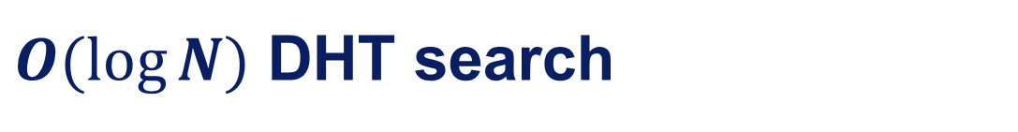
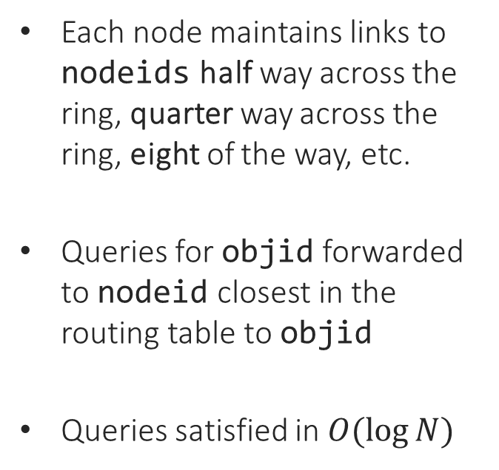
0
FFFFF....F (2¹²⁸-1)
D471F1
D467C4
D46A1C
D462BA
D4213F
D13DA3
65A1FC

Slide 12
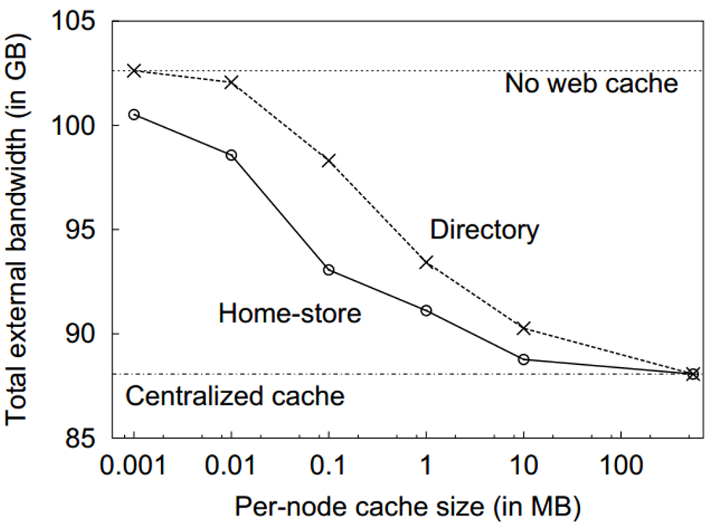
Structured P2P Middleware
Squirrel
Distributed Web cache
MS Research 2002
Stores web objects http://wiki.org/../network.png on nodes within LAN
Performance
Lookups require several LAN hops (~1ms each) vs. WAN latency of (~10-100ms)
Same hit rate as centralized cache with modest per node resources
Notes:
http://research.microsoft.com/pubs/65215/p-squirrel.pdf
Home store - each node holds the object
Directory - each node holds a pointer to the node that stores the object

Slide 13
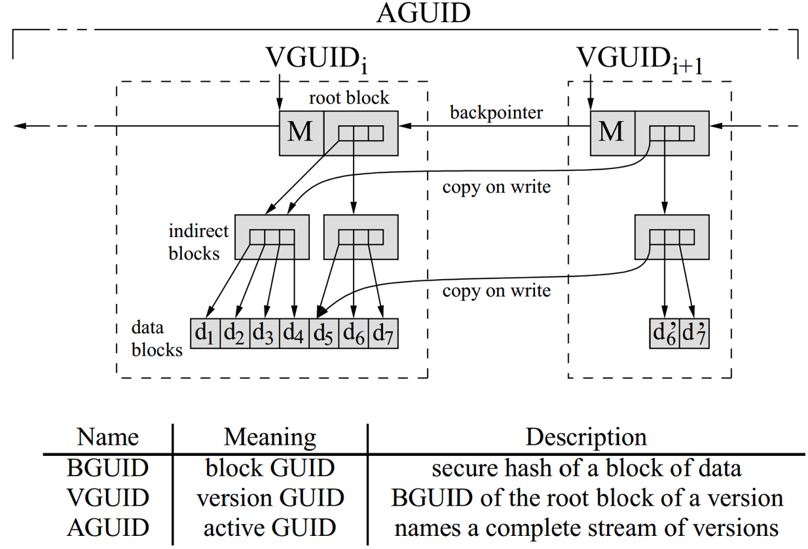
P2P-based Middleware
OceanStore
Distributed file system
Supports mutable objects
Pond prototype 2003 based on Tapestry DHT
- Slower than NFS on LAN
- Both really slow on WAN

Slide 14
Unstructured vs. Structured P2P
 | Unstructured P2P | Structured P2P
Advantages | Self-organizing Naturally resilient to node failure | Guaranteed to locate objects (if exist) Time and complexity bounds Low message overhead
Disadvantages | Cannot offer guarantees on locating objects Prone to excessive messaging that limits scalability | Need to maintain complex overlays High control traffic overhead in dynamic environments

